Slide 1
Greedy Algorithms

Slide 2
Announcements
Exam corrections due Fri
HW 4 due Mon

Slide 3

Making Change
How would you normally make change?

Slide 4
Making Change
How would you normally make change?
Using a “greedy” algorithm
Does it find globally optimal solution?

Slide 5
Making Change
How would you normally make change?
Using a “greedy” algorithm
Does it find globally optimal solution?
Yes, given these denominations.
No for other denominations
e.g. d₁ = 25, d₂ = 10, d₃ = 1. Change due = 30.

Slide 6
Greedy Algorithms
Usually applied to optimization problems, but considered a general purpose technique.
Construct solution through sequence of steps where each step is:
Feasible: satisfies problem’s constraints.
Locally Optimal: has to be best local choice
Irrevocable: once made, choice can’t be changed at later step.

Slide 7
Greedy Example: Best First Search
Sacramento
Like DFS, but takes best edge each time and stops when reaches goal (even if nodes/paths unexplored)
e.g. San Jose to Sacramento
50
San Francisco
83
Stockton
40
43
32
Livermore
Modesto
50
33
312
San Jose
Los Angeles
120
San Diego

Slide 8
Greedy Algorithms
Usually simple and intuitive to implement
For some problems yields global optimal, for others not
Challenge: prove whether greedy finds optimal
Use mathematical induction
Prove on each step that does no worse than any other (including optimal) algorithm

Slide 9
Greedy Example: Best First Search
Best First Search – non-optimal
Path San Jose to Sacramento was not the shortest
A* – greedy alg that is optimal – iff the heuristic h(x) is admissible (never an overestimate) and monotonic (nondecreasing)

Slide 10
Greedy Approaches to Minimum Spanning Trees

Slide 11
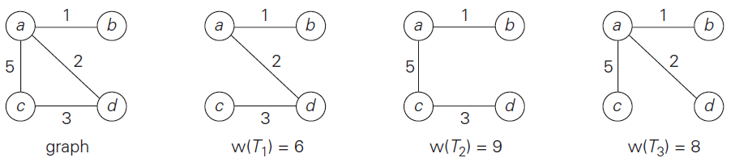
Minimum Spanning Tree Problem
A spanning tree of an undirected graph is connected acyclic subgraph containing all vertices.
If graph has weighted edges, the minimum spanning tree is one with smallest sum weights.
Useful in network design
What spanning trees are possible?
Which one is minimum spanning tree?

Slide 12
Minimum Spanning Tree Problem
A spanning tree of an undirected graph is connected acyclic subgraph containing all vertices.
If graph has weighted edges, the minimum spanning tree is one with smallest sum weights.
Useful in network design

Slide 13
Finding Min Spanning Tree
Brute Force challenging:
Number of spanning trees grows exponentially with graph size.
Generating all possible spanning trees non-trivial.
Greedy: Prim’s Algorithm
Start with single arbitrary vertex.
Each iteration, link one new vertex to tree via min cost edge.

Slide 14
Prim’s Algorithm
b
1
c
3
4
4
6
a
5
f
5
d
6
2
8
e

Slide 15
Prim’s Algorithm
b
1
c
3
4
4
6
a
5
f
5
d
6
2
8
e

Slide 16
Prim’s Algorithm
b
1
c
3
4
4
6
a
5
f
5
d
6
2
8
e

Slide 17
Prim’s Algorithm
b
1
c
3
4
4
6
a
5
f
5
d
6
2
8
e

Slide 18
Prim’s Algorithm
b
1
c
3
4
4
6
a
5
f
5
d
6
2
8
e

Slide 19
Prim’s Algorithm
b
1
c
3
4
a
f
5
d
2
e
How many iterations does Prim’s Algorithm run?

Slide 20
Your Turn …
Apply Prim’s Algorithm to the following:
a
5
b
3
2
7
e
6
4
5
c
4
d

Slide 21
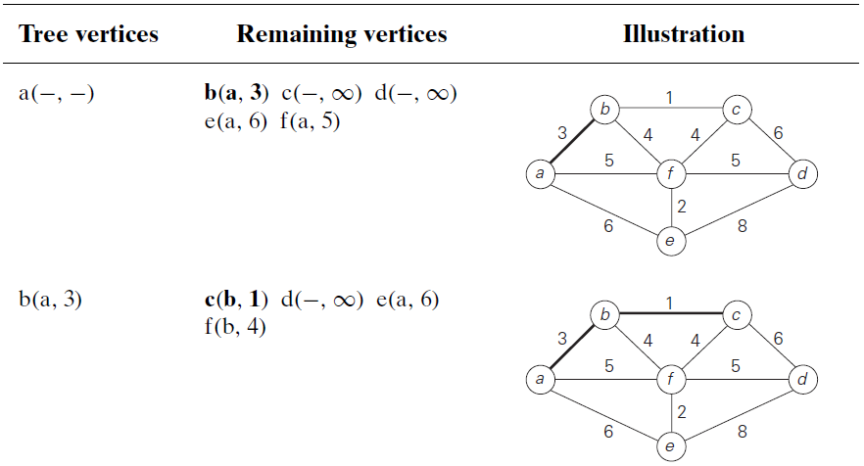
How To Find Nearest Vertex
For nodes not in tree, need to store weight of shortest link into tree (or ∞ if no link).
When a vertex is added to tree, scan its neighbors not in tree and update shortest link cost if shorter than current.
Best structure for storing Remaining Vertices?

Slide 22
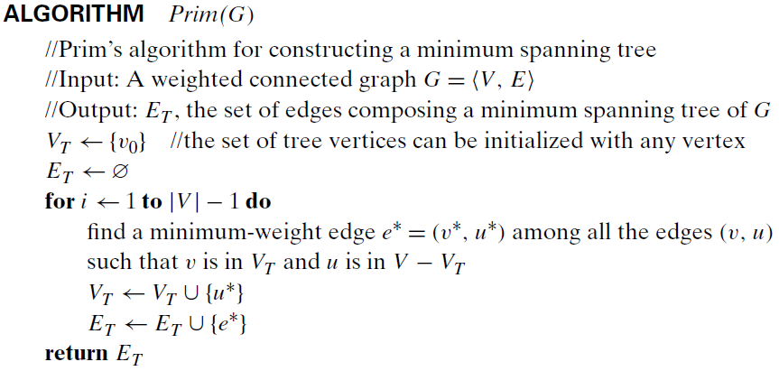
Prim’s Algorithm

Slide 23
Proof of Optimality
By Induction: Show T₀, T₁, …, T_{n-1} is part of minimum spanning tree.
T₀ is just one vertex, must be part of minimum spanning tree.
Assume T_{i-1} generated by Prim’s algorithm is part of minimum spanning tree T then prove T_{i} generated by Prim’s algorithm is also part T.
Prove by Contradiction

Slide 24
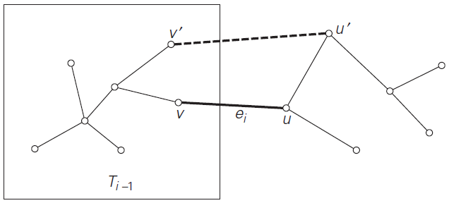
Proof of Optimality
Assume T_{i} is not part of T.
Edge e_{i} is only edge added since T_{i-1}, so must be edge not in T.
Thus adding e_{i} to T would create a cycle:

Slide 25
Proof of Optimality
Assume e_{i} is not part of T.
Must be another edge connecting v’ to u’ in cycle.
Imagine deleting (v’, u’) edge …
New lower cost spanning tree created. Contradiction!

Slide 26
Kruskal’s Algorithm

Slide 27
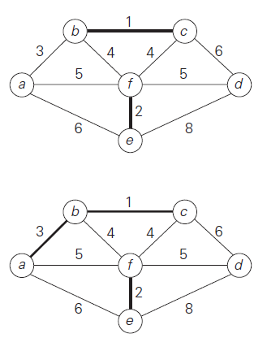
Kruskal’s Algorithm
Sort the edges in non-decreasing order of lengths
Grow tree one edge at a time to produce MST through a series of expanding forests F₁, F₂, …, F_{n-1}
Each iteration: add the next edge in sorted list, skipping edges that would cause cycles.

Slide 28
Kruskal’s Example
4
c
a
(a,c,4), (a,b,2), (b,c,6), (b,d,3), (d,c,1)
6
1
(d,c,1), (a,b,2), (b,d,3), (a,c,4), (b,c,6)
2
d
b
3
c
c
c
a
1
a
1
1
2
2
d
d
b
3
(a,b,2), (b,d,3), (a,c,4), (b,c,6)
d
b
(a,c,4), (b,c,6)
(b,d,3), (a,c,4), (b,c,6)

Slide 29
Your Turn
Apply Kruskal’s Algorithm to:
b
1
c
3
4
4
6
a
5
f
5
d
6
2
8
e

Slide 30
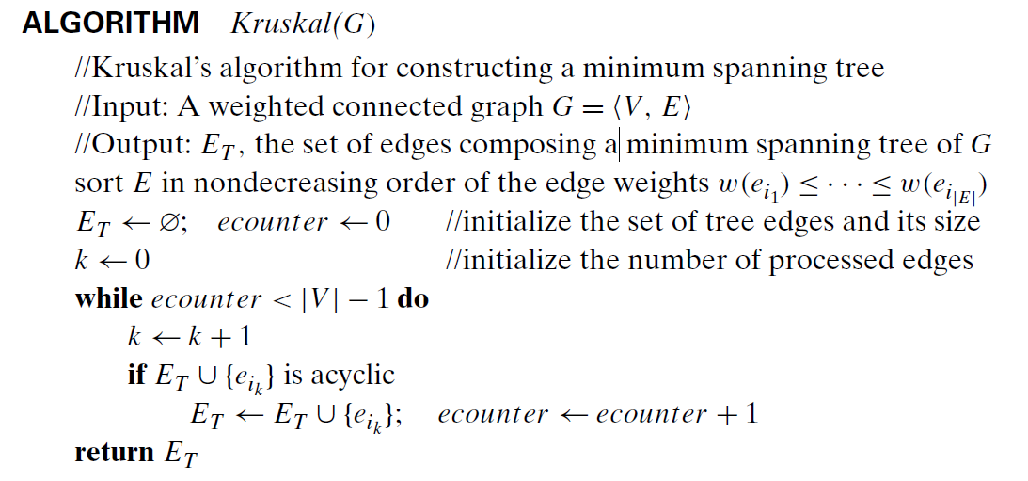
Kruskal’s Algorithm

Slide 31
Notes about Kruskal’s algorithm
Algorithm looks easier than Prim’s but is harder to implement (checking for cycles!)
Cycle checking: a cycle is created iff added edge connects vertices in the same connected component
A disjoint-set data structure is an efficient way to store the vertices in each tree in the forest and to check for cycles

Slide 32
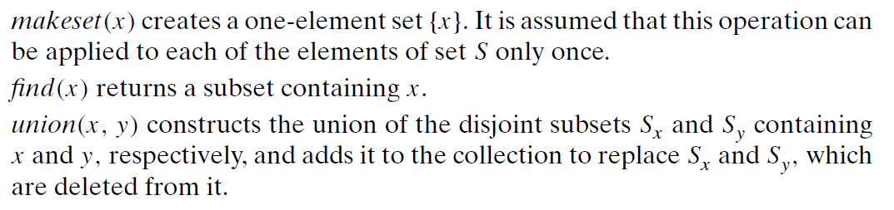
Disjoint-Set
Disjoint-set operations:

Slide 33
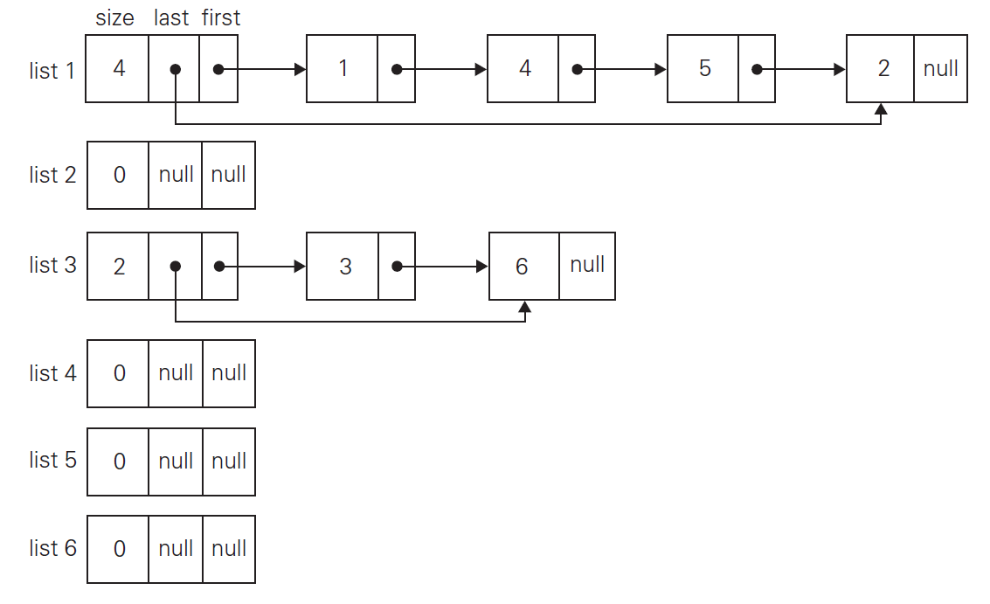
Disjoint-Set Example
S = { 1, 2, 3, 4, 5, 6 }
makesets(S);
union(1,4);
union(5,2);
union(3,6);
…

Slide 34
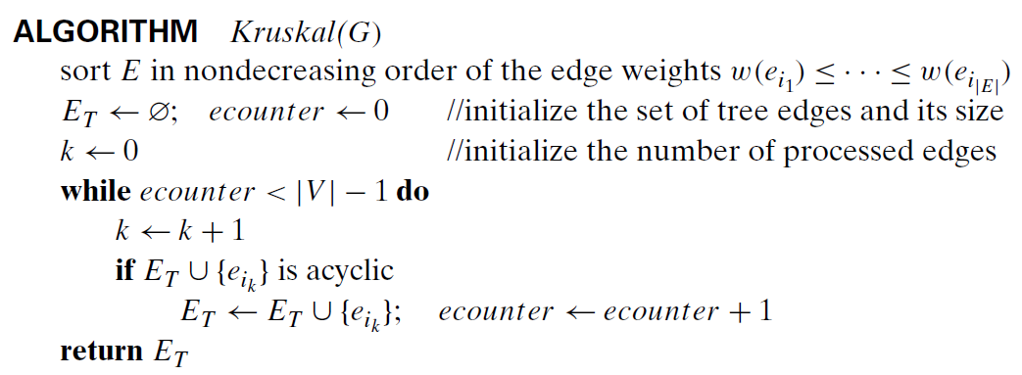
Kruskal’s Algorithm using DSS
Initialize DSS with all vertices
Test for cycles will check if vertices connected by edge are in same subset.
If edge is added, merge forests by union of corresponding subsets.

